Slide 1

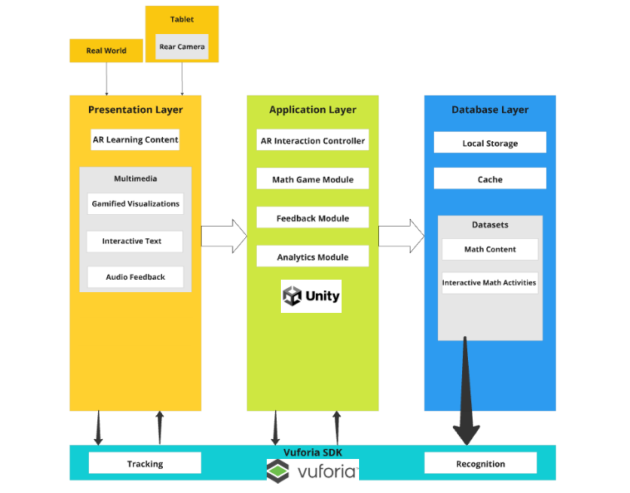
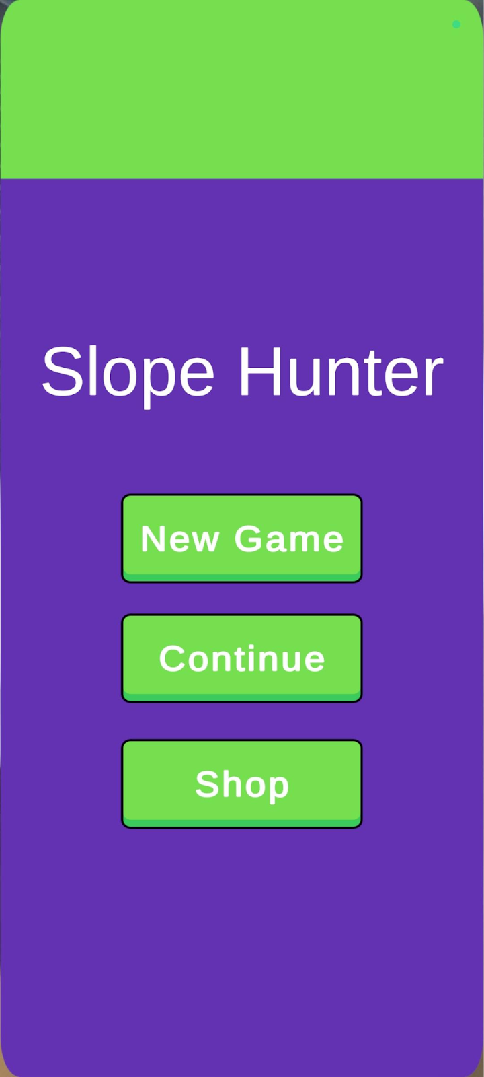
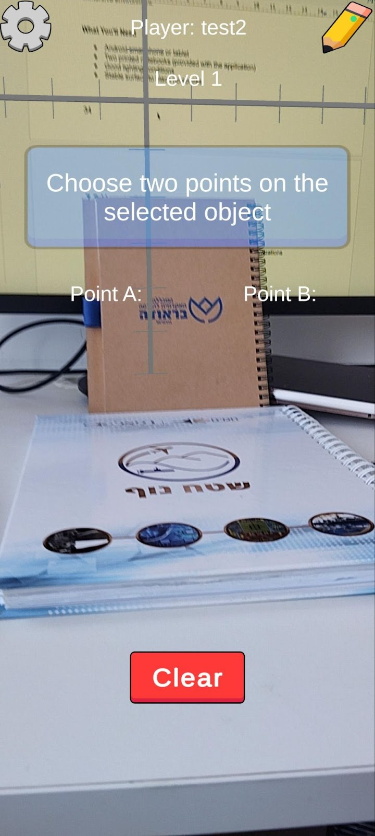
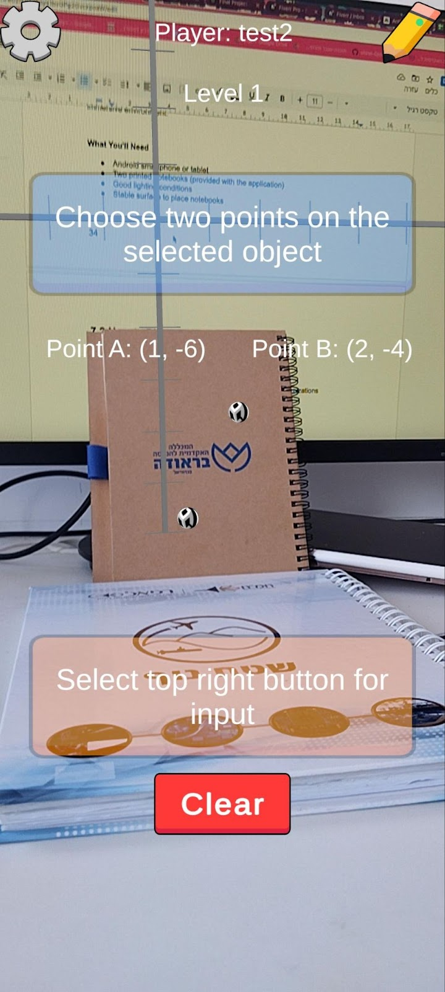
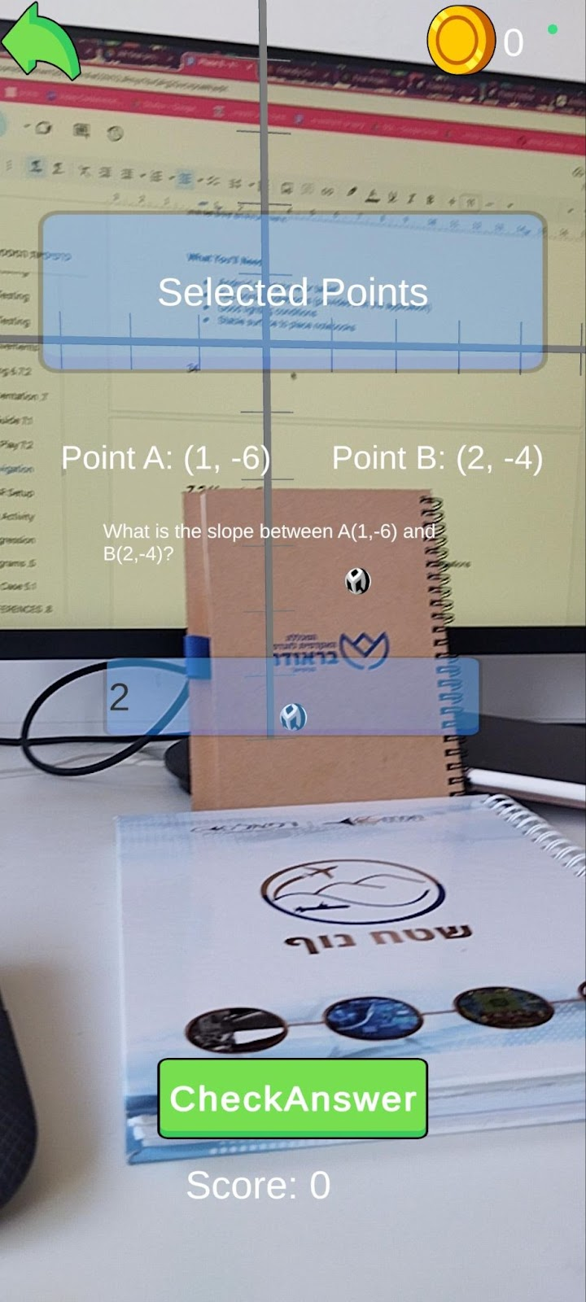
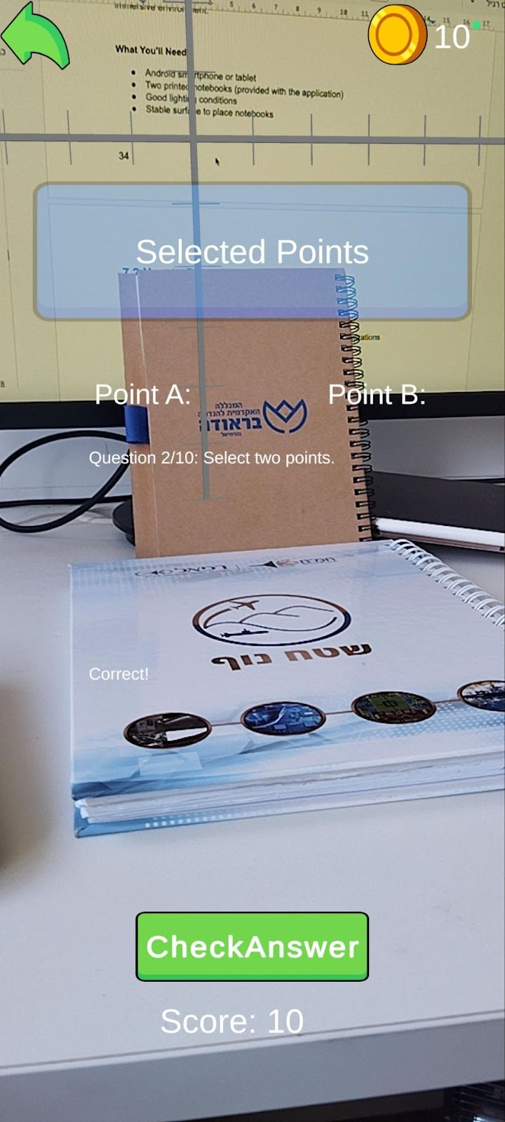
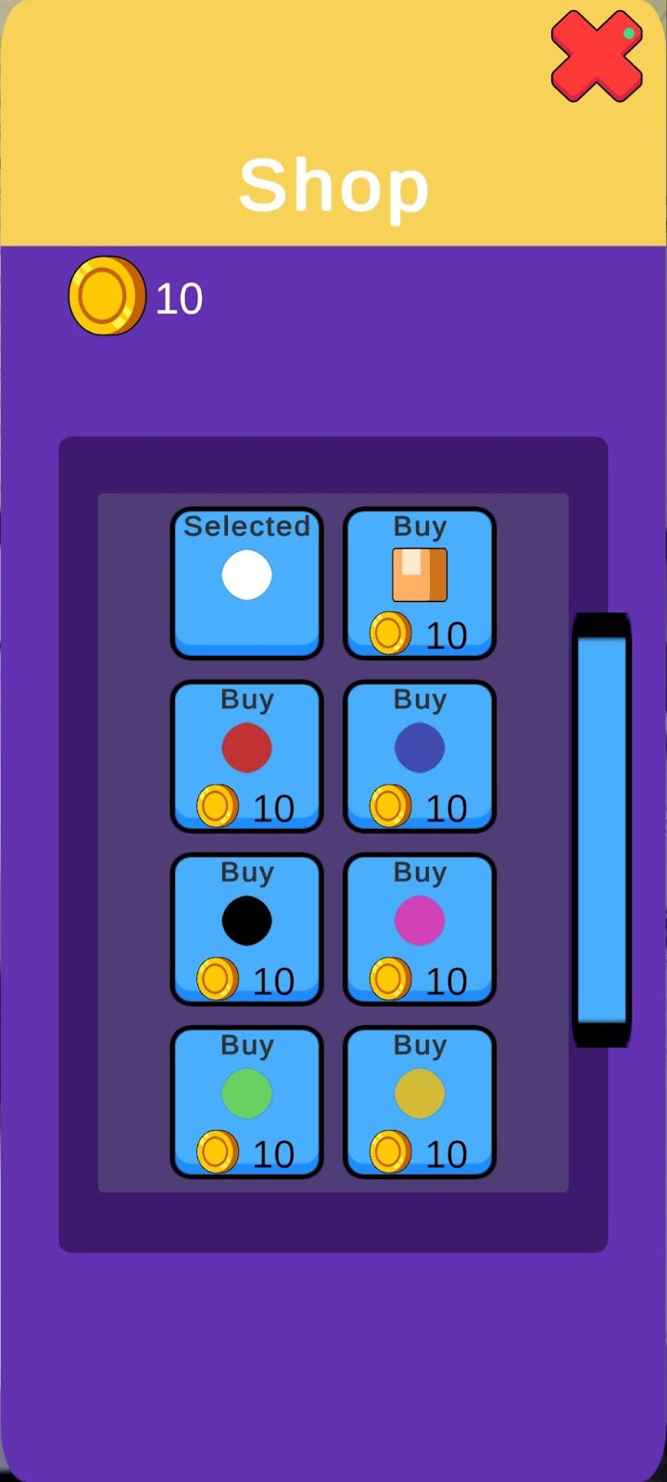
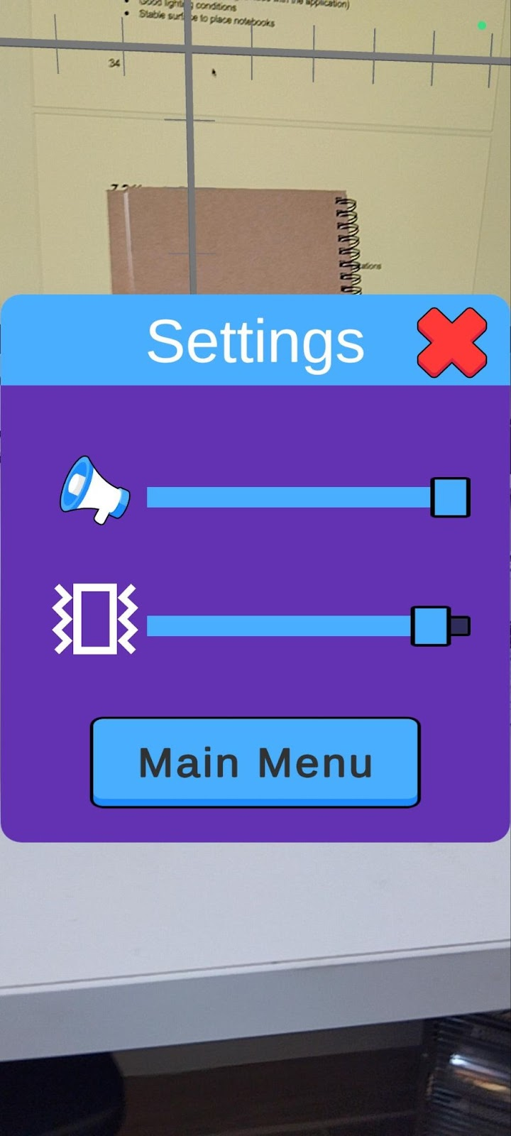
Slope Hunter
Shirel Goldenberg & Kfir Hemo
Advisors - Dr. Unkelos Shpigel Naomi
Dr. Natali Levi-Soskin
Mathematics is often perceived as abstract and difficult by students, leading to disengagement and low retention. Traditional teaching methods fail to address diverse learning needs. Our project, slope hunter, introduces an Augmented Reality (AR) educational game that transforms slope calculation into a tangible, engaging experience. By scanning real notebooks and interacting with virtual math structures, students gain a deeper understanding and motivation to learn through immersive play.
The application architecture
Core System Requirements
Marker recognition using Vuforia – detect and track the Fixed and Slope notebooks (Functional)
Interactive point placement via touch-based raycasting (Functional)
Real-time slope calculation and validation (Functional)
Immediate visual and textual feedback on answer correctness (Functional)
Gamification features (points, levels, badges, rewards) (Functional)
Support for Android tablets (touch devices) (Non-Functional)
Offline functionality – app runs without internet (Non-Functional)
Accessibility options – large buttons, color-blind modes, audio hints (Non-Functional)
Responsive and intuitive UI/UX for students and teachers (Non-Functional)
Performance requirement – app runs at ≥30 FPS on low-tier devices (Non-Functional)
Security for stored data (if analytics or future user profiles) (Non-Functional)
Scalability for future analytics and server-side features (Non-Functional)
Screenshots
Tracking Challenges Matrix
Challenge | Impact | Solution Implemented | Effectiveness
Inconsistent Lighting Conditions | Tracking failures in varied classroom lighting | Implemented adaptive thresholding algorithms in Vuforia configuration | 85% reduction in lighting-related tracking failures
Notebook Surface Reflections | Glare interfering with target recognition | Modified target design with matte-finish printing; Added anti-glare detection logic | Reduced reflection issues by 78%
Multiple Target Manage ment | Difficulty tracking both notebooks simultaneously | Implemented priority-based tracking system with spatial relationship anchoring | Improved multi-target stability by 92%
Tracking Stability During Movement | Loss of tracking when device moved quickly | Extended tracking with gyroscope data fusion and predictive positioning | Reduced tracking loss during movement by 73%
Target Partial Occlusion | Tracking loss when part of notebook covered | Implemented partial feature recognition with confidence thresholds | System now maintains tracking with up to 40% occlusion
Technical Performance Results
AR tracking was accurate: both Fixed and Slope notebooks were reliably detected.
Coordinate mapping was precise, allowing for accurate point placement.
Real-time feedback was provided instantly upon point selection.
UI remained stable and responsive throughout the interaction.
Users successfully selected points, triggering correct slope validation.
"Correct!" message confirmed accurate answers.
Score system worked (e.g., “Score: 10”), supporting gamification.
Sequential question system (e.g., “Question 2/10”) guided user progress.

